Slide 1
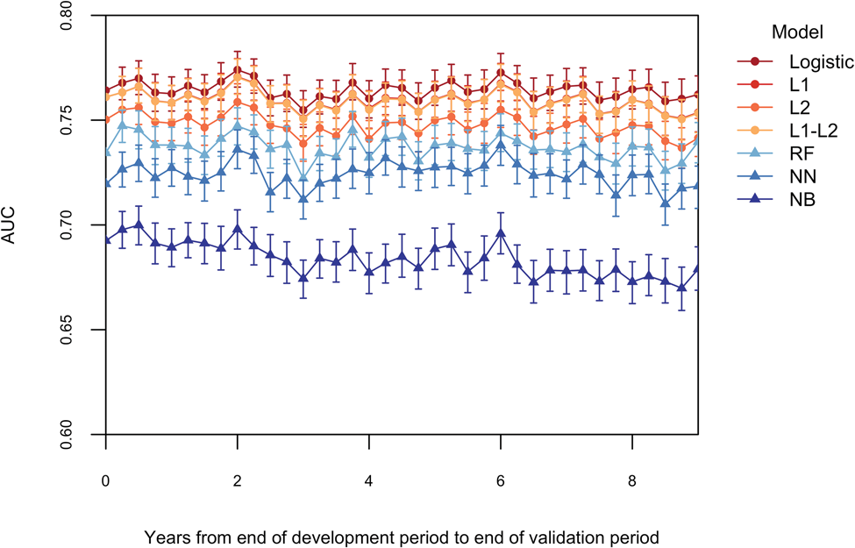

Figure 1. Discrimination over time by modeling method. Regression models – logistic regression (LR), L-1 penalized ...
Notes:
Figure 1. Discrimination over time by modeling method. Regression models – logistic regression (LR), L-1 penalized logistic regression (L1), L-2 penalized logistic regression (L2), and L-1/L-2 penalized logistic regression (L1-L2) – are displayed with circular markers and red-orange colors. Machine learning models – random forest (RF), neural network (NN), and naïve Bayes (NB) – are displayed with triangular markers and blue-purple colors.
Unless provided in the caption above, the following copyright applies to the content of this slide: © The Author 2017. Published by Oxford University Press on behalf of the American Medical Informatics Association. All rights reserved. For Permissions, please email: journals.permissions@oup.com

